Slide 1




NEXT GEN EMPLOYABILITY PROGRAM
Creating a future-ready workforce
Team Members
College Name
Student Name : JOSHNA ACSHA S
Student ID : au311121104029
Loyola I-cam College Of Engineering and Technology

Slide 2

CAPSTONE PROJECT SHOWCASE
Project Title
MUSIC WEB APPLICATION USING DJANGO FRAMEWORK
Abstract | Problem Statement | Project Overview | Proposed Solution | Technology Used | Modelling & Results | Conclusion

Slide 3
Abstract
The Django Music App is a web application developed using the Django framework.
It offers a seamless music listening experience with a user-friendly interface.
Key features include trending songs, personalized playlists, and a comprehensive song library.
The home page features a captivating picture, trending songs, and listen later song sections.
User authentication functionalities allow users to create accounts and log in.
This presentation provides an overview of the app's functionalities and potential future enhancements.
Source :

Slide 4
Problem Statement
The music industry offers a vast array of songs and genres, making it challenging for users to discover new music and manage their playlists effectively.
Existing music applications may lack intuitive interfaces and efficient organization systems, leading to user frustration and dissatisfaction.
Users often struggle to find a music platform that caters to their specific preferences and provides a seamless listening experience.
There is a need for a music application that offers a user-friendly interface, efficient organization of songs, and easy navigation for users to explore and enjoy music hassle-free.
The Django Music App aims to address these challenges by providing a user-centric platform that prioritizes ease of use and streamlined music management for listeners.
Source :

Slide 5
Project Overview
User Authentication: The app allows users to create accounts, log in, and manage their profiles securely.
Home Page: The home page serves as the central hub for users, featuring a captivating image, trending songs, and a section for songs added to the "listen later" list.
All Songs Page: Users can explore a comprehensive library of songs categorized by tags, genres, and other criteria.
Song Details Page: Each song has a dedicated details page displaying information such as title, artist, genre, and movie association.
Search Functionality: The app includes a search feature that enables users to find specific songs or artists quickly.
Upload Music: Users can upload music which will then be displayed in their channel.
History: The history of previously listened songs by the user will be visible here.
Source :

Slide 6
Proposed Solution
User-Centric Interface: The app will feature a modern and intuitive user interface designed to provide easy navigation and seamless interaction.
Comprehensive Music Library: A vast collection of songs spanning various genres, artists, albums, and playlists will be available to users for exploration and discovery.
Search Capabilities: Users will have access to advanced search functionality, allowing them to find specific songs, artists, or albums quickly and efficiently.
User Authentication and Security: Robust user authentication mechanisms will be implemented to ensure the security and privacy of user accounts and data.
Responsive Design: The application will be developed with a responsive design approach, ensuring compatibility and optimal user experience across various devices and screen sizes.
Source :

Slide 7
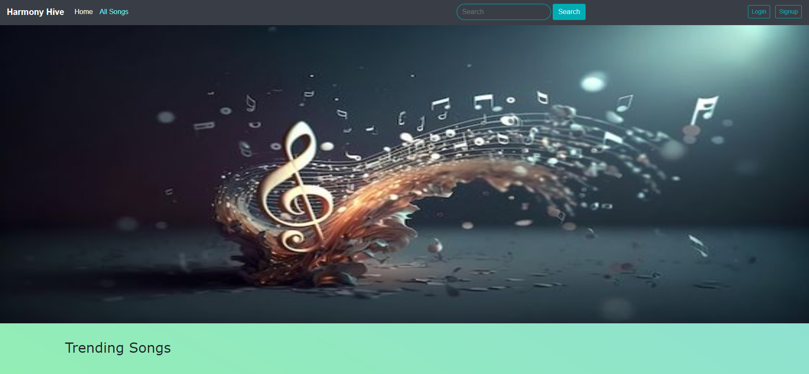
HOME PAGE
Source :

Slide 8
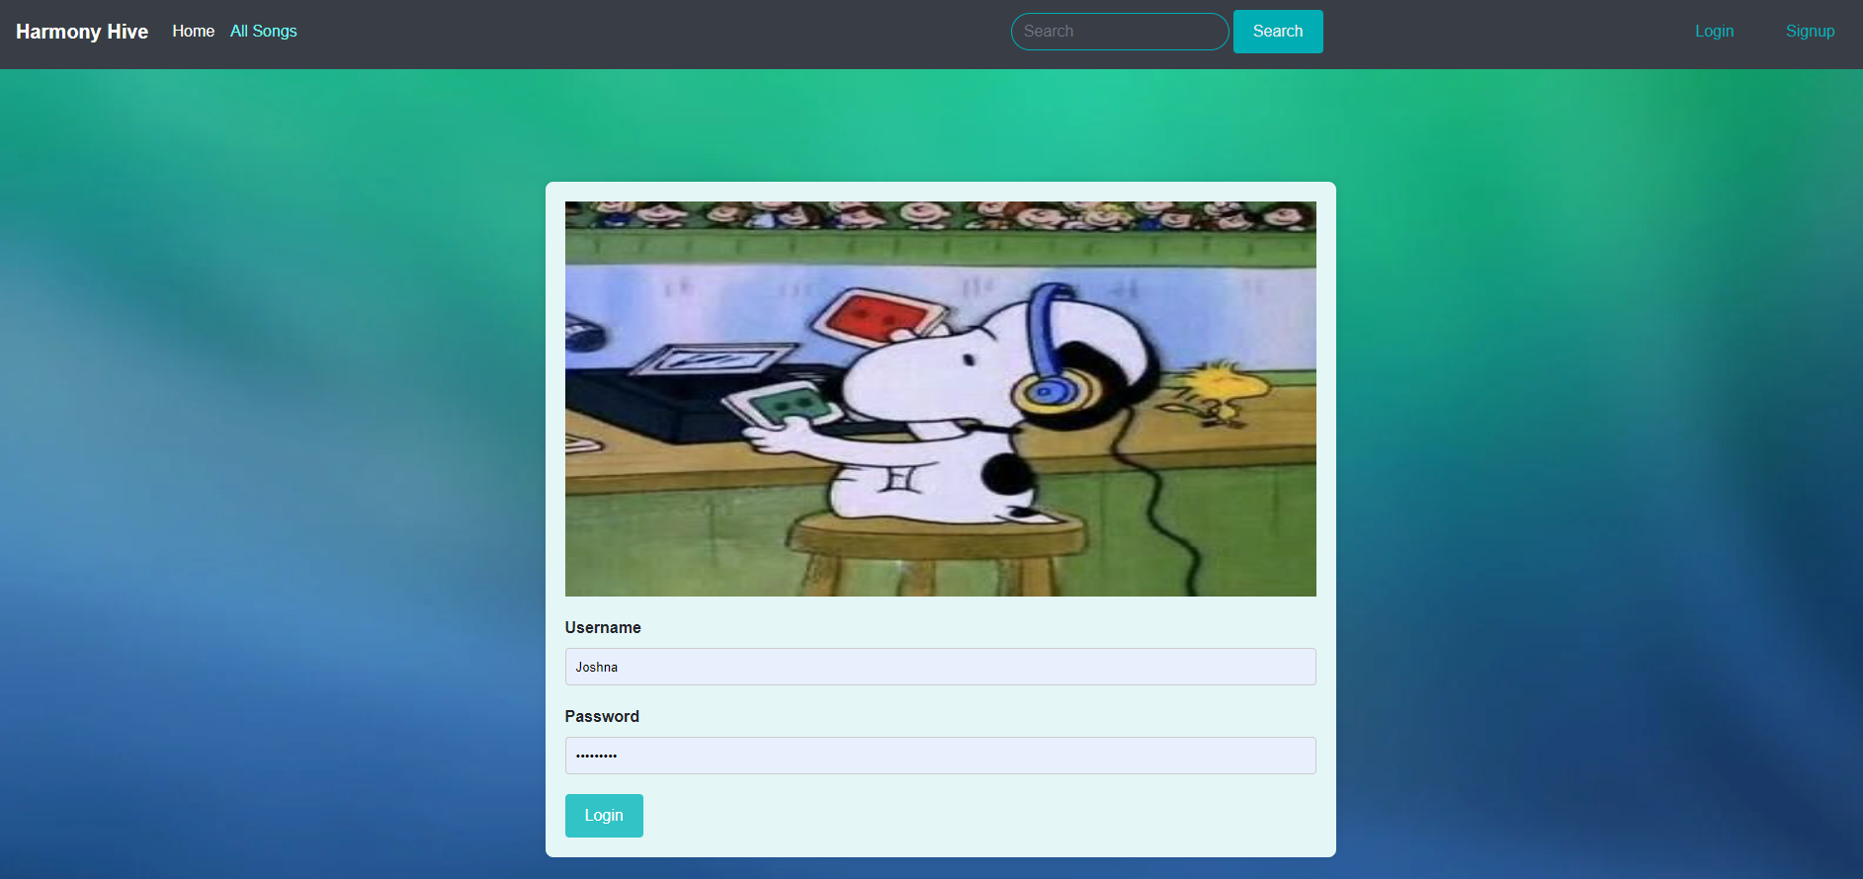
LOGIN PAGE
Source :

Slide 9
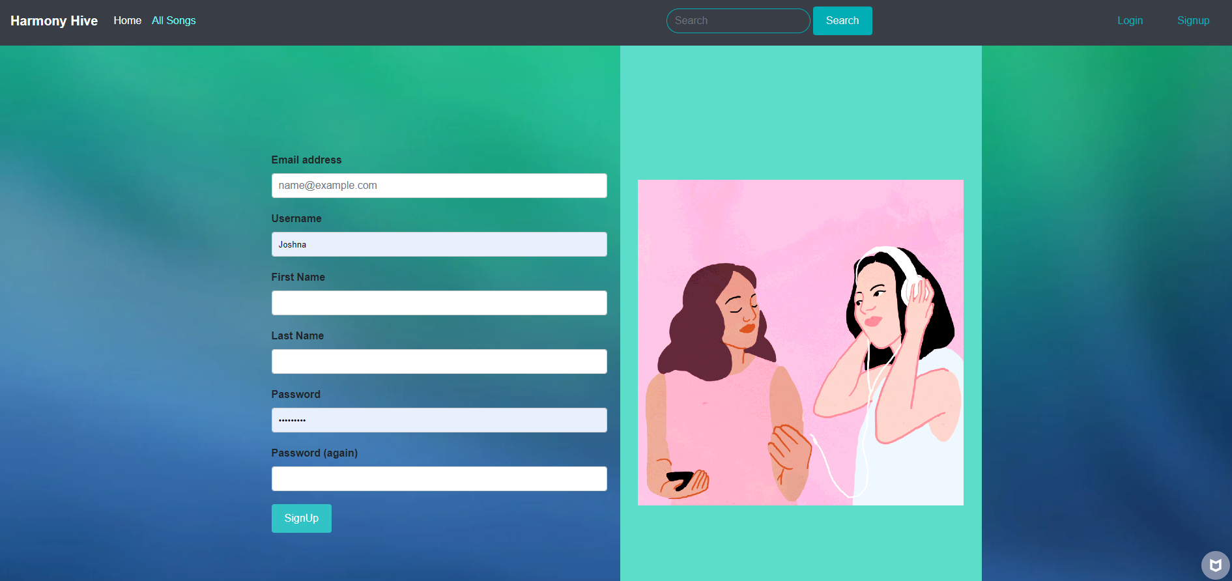
SIGN UP PAGE
Source :

Slide 10
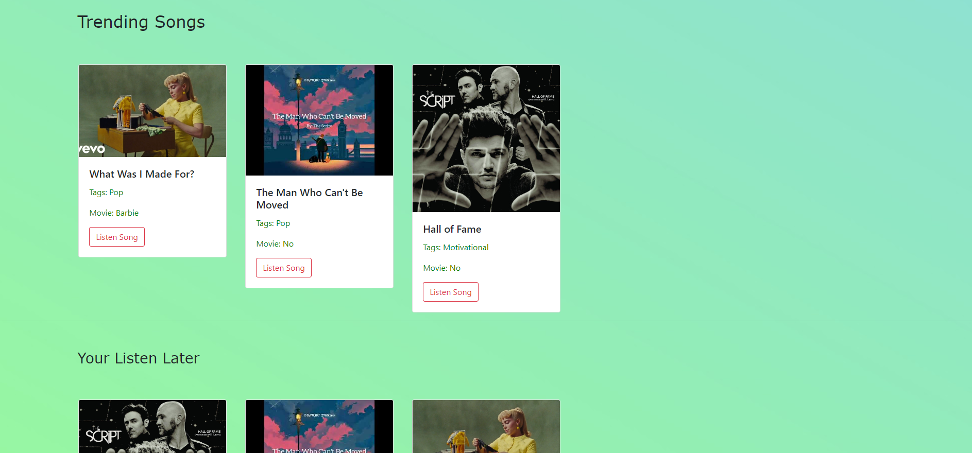
TRENDING SONGS AND LISTEN LATER SONGS
Source :

Slide 11
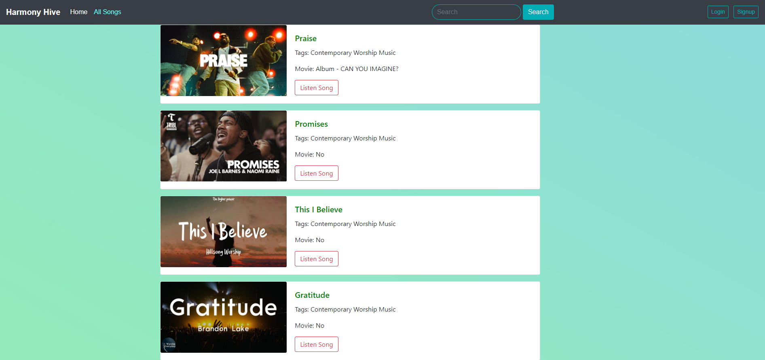
ALL SONGS PAGE
Source :

Slide 12
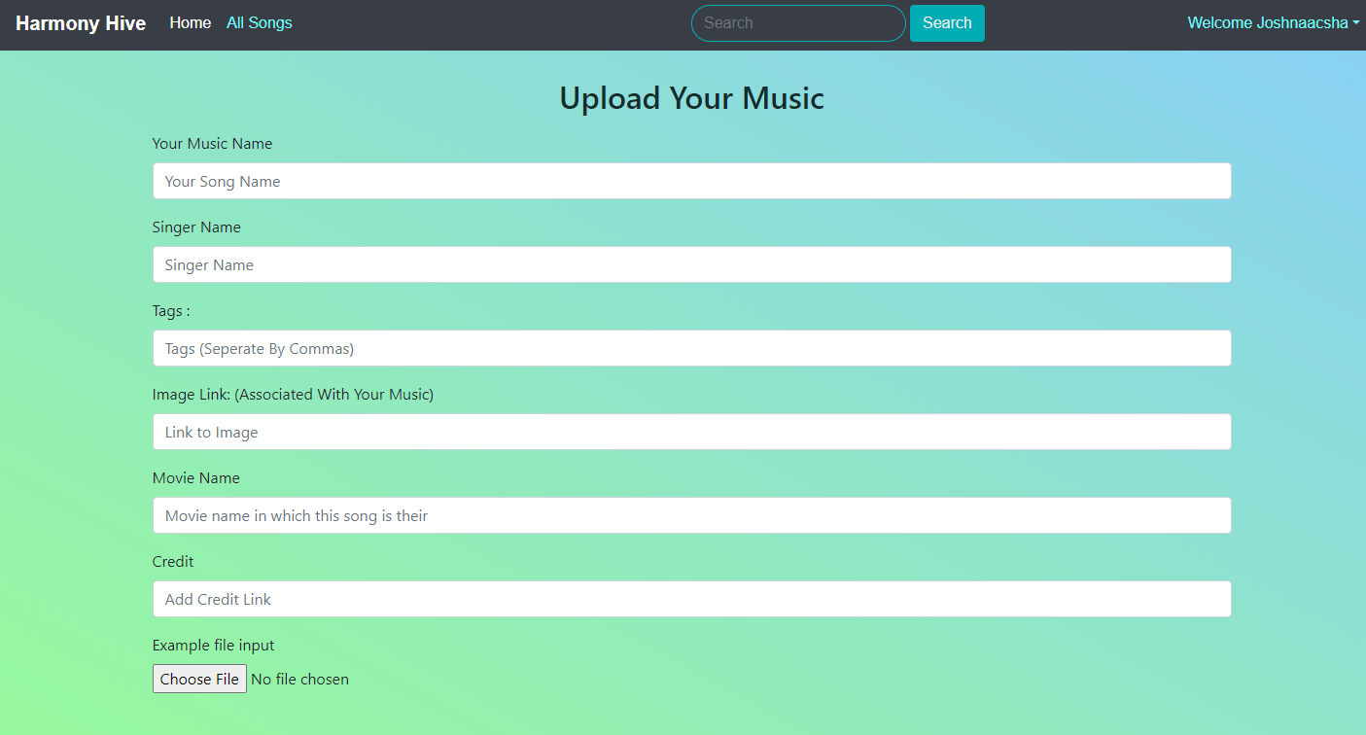
UPLOAD MUSIC
Source :

Slide 13
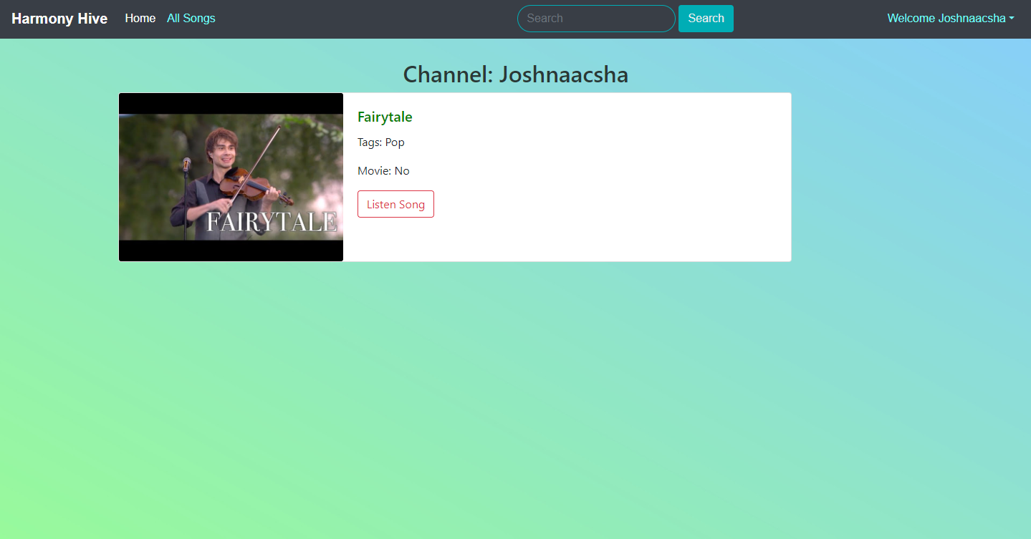
MY CHANNEL PAGE
Source :

Slide 14
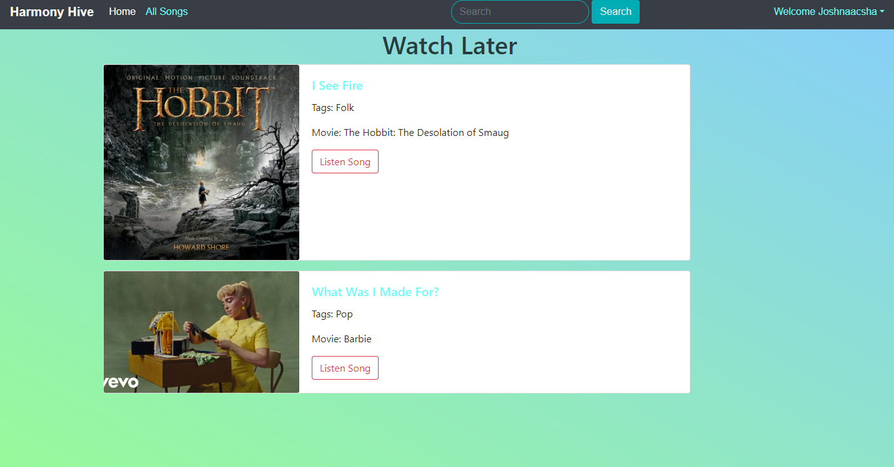
LISTEN LATER PAGE
Source :

Slide 15
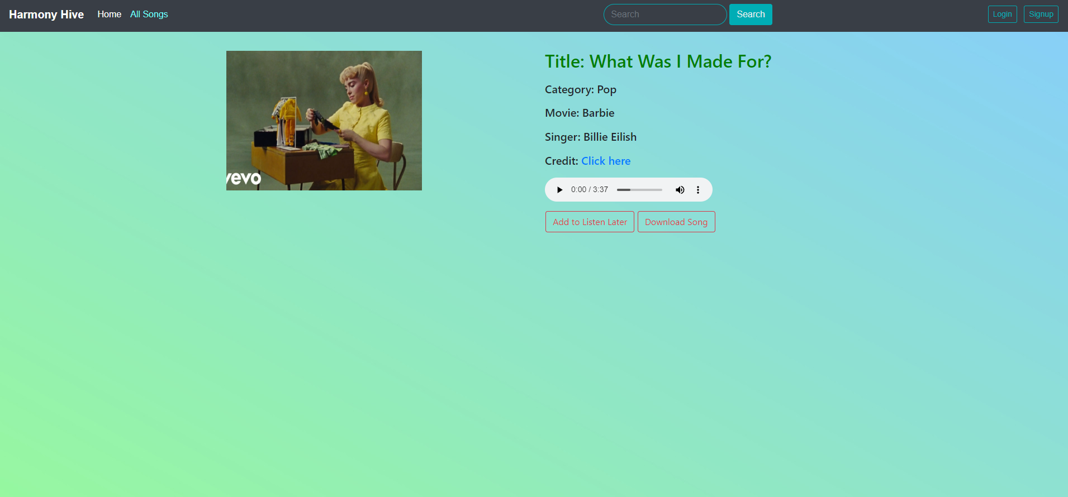
HISTORY
Source :

Slide 16
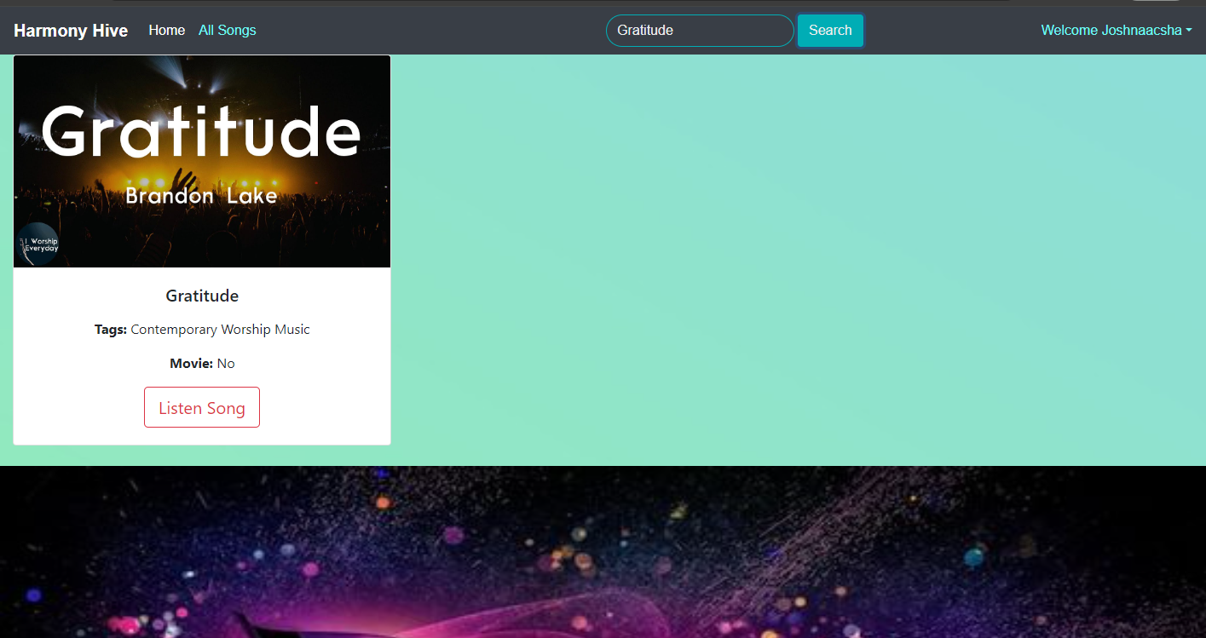
SEARCH FOR SONGS
Source :

Slide 17


Technology Used
Front-end
Back-end
Source :

Slide 18
Modelling & Results
Modelling:
User Profiles: Each user will have a profile containing basic information and preferences.
Songs: The main entity representing individual songs, including attributes such as title, artist, genre, etc.
Tags and Genres: Songs will be categorized using tags and genres for easy browsing.
Authentication and Authorization: Secure access to user accounts and data.
to boost user engagement and retention.
Source :

Slide 19
Modelling & Results (Continuation)
Results:
Efficient Data Management: Optimal storage, retrieval, and manipulation of songs, playlists, and user data.
Enhanced User Experience: Intuitive navigation, responsive design, and personalized recommendations for an enjoyable music exploration.
Increased Engagement: Diverse features like songs management, advanced search, and listen later options
Trending Songs: Suggest to user in the home page on songs to listen based on the recently trending songs.
Source :

Slide 20
Homepage
Introduction to the Home Page:
Central hub of the platform.
Provides an overview of available features and content.
Login and Sign-Up Options:
Convenient access to existing accounts or sign up for new ones.
Search Functionality:
Allows users to discover specific songs, artists, albums, or genres.
Enhances user experience and navigation efficiency.

Slide 21
Homepage (Continuation)
Trending Songs:
Highlights latest music trends and popular tracks.
Dynamically updated based on user engagement.
Listen Later Feature:
Enables bookmarking and organization of songs for later listening.
Can listen to favorite songs later.

Slide 22
Homepage (Continuation)
Upload Music:
Users can upload music and it will be displayed in their channel.
My Channel:
All songs that are added by the user will be visible in the my channel page.
History:
History page will have the history of the songs listened previously by the user.
Watch Later:
This Page will have the list of music that the user added to “Listen Later”.

Slide 23
Log In Page
Purpose: Gateway for registered users to access their accounts securely.
Functionality:
Users enter credentials (username/email, password) for authentication.
Options for password recovery or account troubleshooting.
User Experience: Streamlined interface with error handling for smooth login.
Security Measures: Robust authentication and protection against unauthorized access.
Customization: Personalized messages and integration with social login options.

Slide 24
Sign-Up Page
Purpose: Facilitates creation of new user accounts for personalized experiences.
Registration Process: Users provide necessary information and validate account via email.
Onboarding Experience: Guided process with clear instructions and accessibility features.
Accessibility: Compliance with standards for inclusivity and usability.
Data Privacy: Transparent disclosure and compliance with privacy regulations.

Slide 25
All Songs Page
All Songs Section:
Access to extensive collection of music across genres, artists, and albums.
Discover new music and enjoy diverse musical experiences.
Listening Options:
Flexibility to stream songs directly or download for offline playback.
Streaming for instant access, downloading for offline enjoyment.

Slide 26
Future Enhancements:
Machine Learning Algorithms: Utilize machine learning to analyze user data and suggest songs based on preferences.
Collaborative Filtering: Implement collaborative filtering to recommend songs based on user similarities.
Real-Time Updates: Ensure recommendations are updated in real-time based on user interactions.
User Feedback Integration: Allow users to provide feedback on recommended songs to improve future suggestions.
Content-Based Filtering: Implement content-based filtering to recommend songs similar to those previously liked or listened to by the user.
Diverse Recommendation Sources: Explore integration with diverse recommendation sources to offer a wider range of music options.

Slide 27
Conclusion
The Django Music App offers a comprehensive solution to challenges in music discovery and enjoyment.
Leveraging a robust data model, it facilitates efficient organization and management of songs and user data.
With features like user profiles and personalized recommendations, it enhances user engagement and satisfaction.
The app's intuitive interface and responsive design ensure a seamless and enjoyable user experience.
Continuous improvement and updates are planned to further enhance functionality and user satisfaction.
In summary, the Django Music App is poised to revolutionize online music consumption, providing users with a rich and immersive listening experience.
Source :

Slide 28
Thank You!
Notes:
Thank You !!

